Slide 1
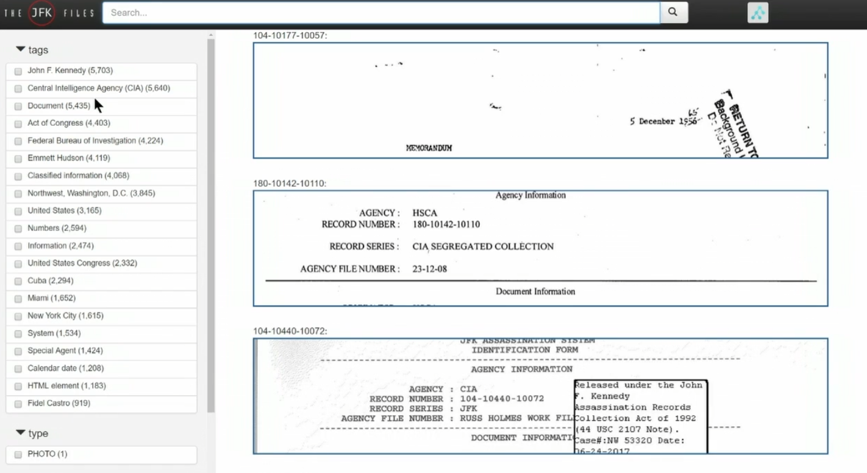
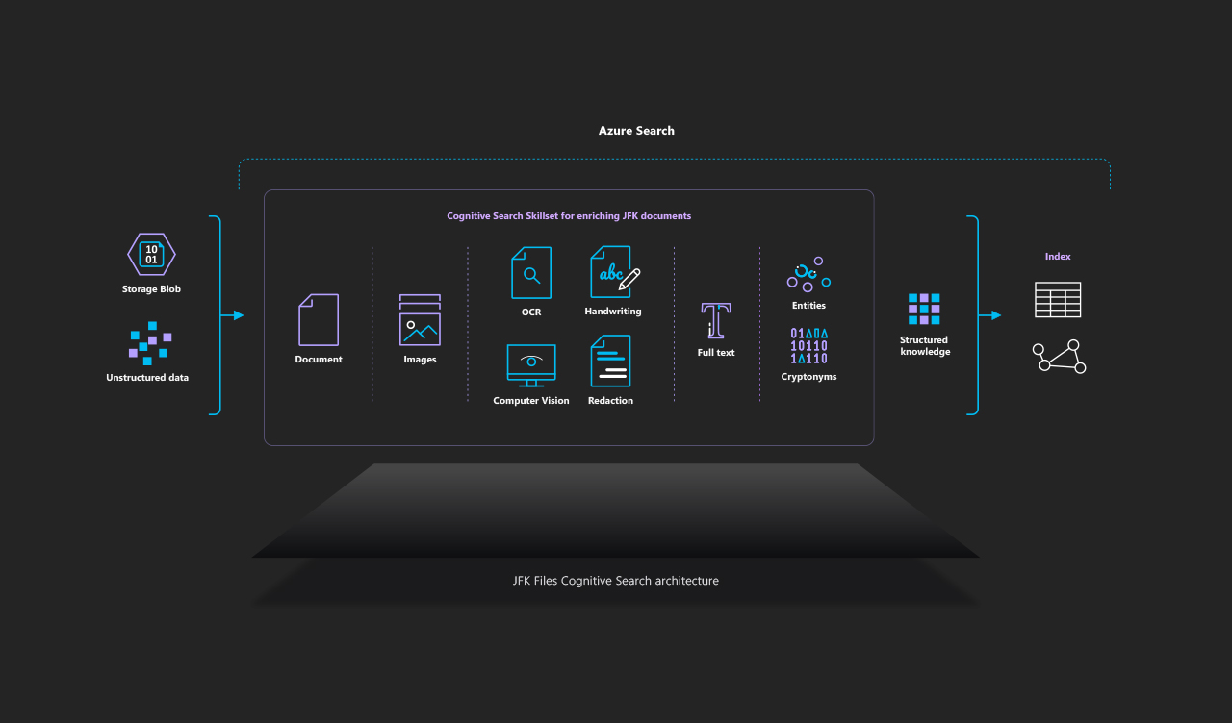
Microsoft AI Platform – JFK Files AI Search
Business Need
Microsoft developed a demo application to showcase Azure Cognitive Search and AI enrichment using the JFK Files dataset. As a customer-facing demonstration, the solution needed to function reliably during live demos and self-guided exploration. Microsoft engaged Affirma to provide quality assurance support to validate core functionality, usability, and overall demo readiness.
What we Did
Performed functional testing of search, filtering, and document viewing experiences
Validated AI-generated outputs such as OCR text and entity highlights for usability and accuracy
Conducted exploratory testing to identify issues that could impact live demos
Logged and tracked issues with clear reproduction steps to support quick resolution
Outcomes
Improved demo reliability and reduced risk during customer and partner presentations
Identified usability and functional issues that could distract from the demo experience
Increased confidence in the solution’s readiness as a public-facing Azure showcase

